Slide 1
Sentiment Analysis of Restaurant Reviews
CAPSTONE PROJECT
Presented By:
Student Name : Mudgolwad Ravi
College Name & Department : JNTUH COLLEGE OF ENGINEERING SULTANPUR
CSE(AI&ML)

Slide 2
OUTLINE
Problem Statement
Technology used
Wow factor
End users
Result
Conclusion
Git-hub Link
Future scope

Slide 3
Problem Statement
Analyzing customer reviews of restaurants to determine sentiments as positive or negative.
This helps businesses identify areas of improvement and strengths based on feedback.
Efficient sentiment analysis can improve customer satisfaction and loyalty.
The aim is to automate the process using machine learning techniques

Slide 4
Technology used
Programming Language: Python
IDE: Google Collab
Libraries:
- pandas for data handling
- nltk for text preprocessing
- scikit-learn for machine learning models

Slide 5
Wow factors
Comparison of multiple machine learning algorithms: Naive Bayes, Logistic Regression, Random Forest, and SVM.
Text preprocessing techniques, including stemming and stopword removal.
Implementation of TF-IDF for vectorizing text data.
PCA for dimensionality reduction and standardization of features.

Slide 6
End users
Restaurant owners and managers for understanding customer feedback.
Data analysts for deriving insights from textual data.
Researchers working on natural language processing.

Slide 7
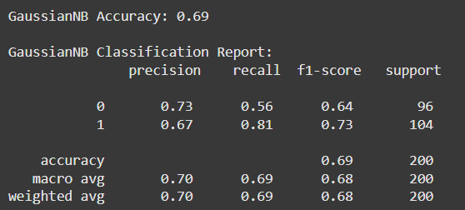
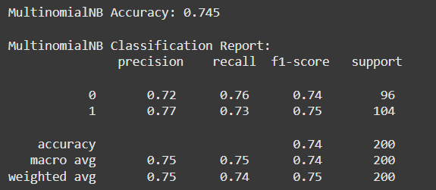
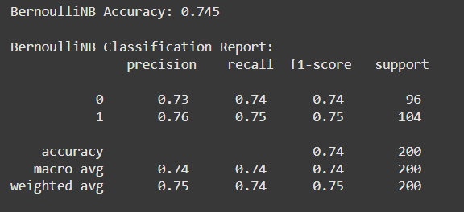
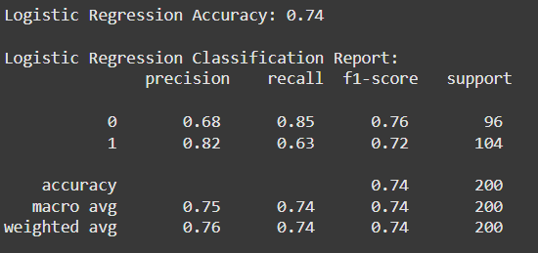
Results

Slide 8
Accuracy Comparisons:
1. GaussianNB: 69%
2. MultinomialNB: 74.5%
3. BernoulliNB: 74.5%
4. Logistic Regression: 74%
5. Random Forest: 70%
6. SVM: 74%
Conclusion: MultinomialNB and BernoulliNB outperform other classifiers in this scenario.

Slide 9
Conclusion
Sentiment analysis effectively identifies positive and negative reviews, aiding restaurants in understanding customer sentiment.
The best-performing models (MultinomialNB and BernoulliNB) provide a balanced approach to accuracy and generalizability.

Slide 10
GitHub Link
Link: https://github.com/mudgolwadravi/IBM-EduNet-DGT-NLP-AI-.git

Slide 11
Future scope(optional)
Integrating deep learning models such as BERT for better accuracy.
Expanding the dataset to include multi-language reviews.
Real-time sentiment analysis for immediate feedback.

Slide 12
THANK YOU

